Slide 1
Chapter Eleven
Prosocial Behvaior:
Empathy and Egotism
Positive Psychology: The Scientific and Practical Explorations of Human Strengths © 2014 SAGE

Slide 2
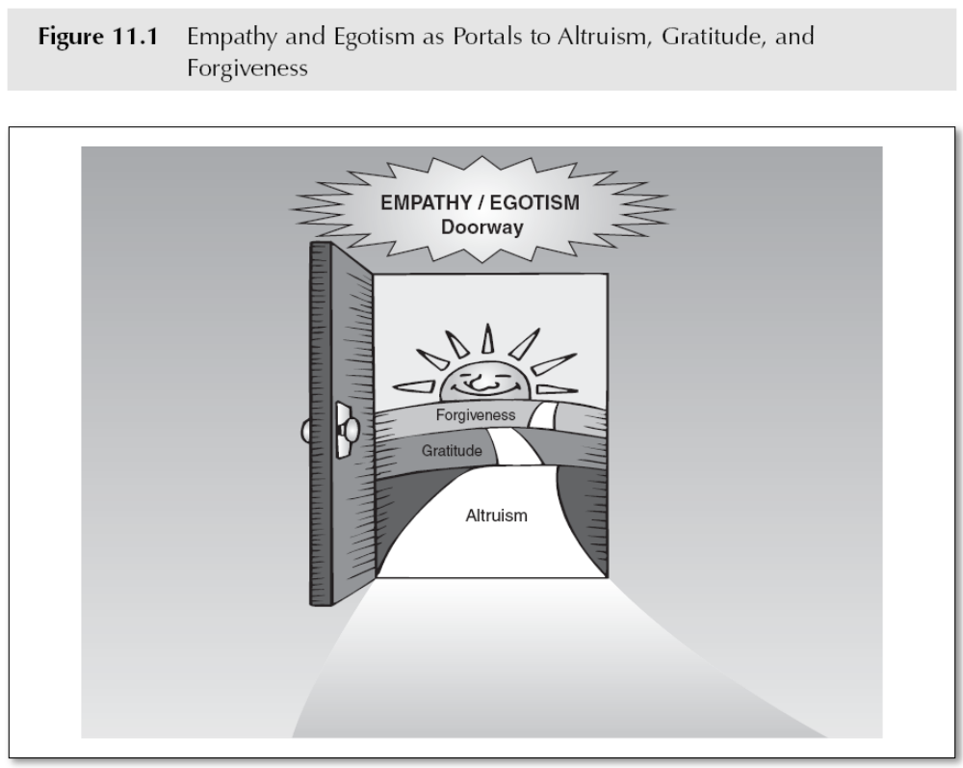
Empathy and Egotism
Positive Psychology: The Scientific and Practical Explorations of Human Strengths © 2014 SAGE
Notes:
Confirm that this diagram still exists and is numbered properly

Slide 3
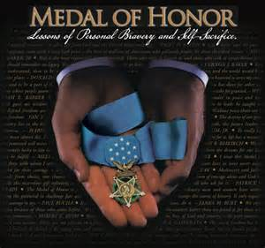
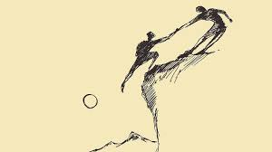
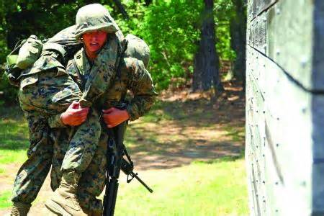
Altruism
Behavior aimed at benefitting another person
Volunteerism - a related concept
Positive Psychology: The Scientific and Practical Explorations of Human Strengths © 2014 SAGE

Slide 4
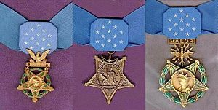
Congressional Medal of Honor
USA highest military honor
Awarded for personal acts of valor that go above and beyond the call of duty
Awarded by the President
3 versions: 1 for Navy, Marine Corps,
and Coast Guard, 1 for Army, 1 for Air Force
Created in 1861 during Civil War
3,500 medals awarded thus far (as of 11/2017)
March 25th National Medal of Honor Day
http://www.cmohs.org/

Slide 5
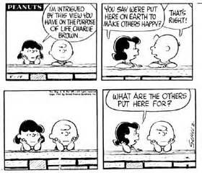
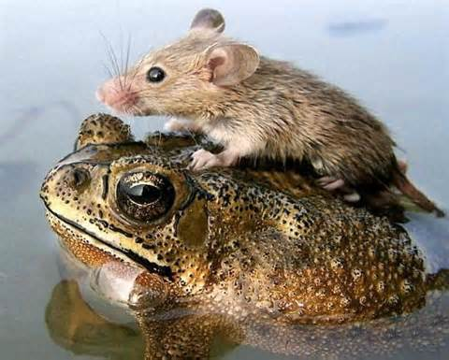
Altruism
Motivated by:
  Personal egotism
  Empathy…desire to benefit another
Other suggested motivations:
  Collectivism: valuing group over self
  Principalism: moral integrity
Positive Psychology: The Scientific and Practical Explorations of Human Strengths © 2014 SAGE

Slide 6
3 Types of Altruism
Reciprocity-based
  Usually egotistic because perform a helping behavior in the hope that the other will help you
Care-based
  Help because of feelings of empathy for recipient
Kin-based
Positive Psychology: The Scientific and Practical Explorations of Human Strengths © 2014 SAGE

Slide 7
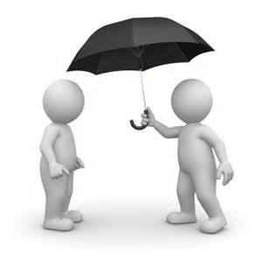
Altruism – The Egotism Motive
The motive to pursue some sort of personal gain or benefit through targeted behavior
One of the most influential of all human motives
Positive Psychology: The Scientific and Practical Explorations of Human Strengths © 2014 SAGE

Slide 8
Altruism – The Egotism Motive
We care for others because it benefits us
Many argue that all altruism is motivated by egotism
- underlying personal benefit even if not intended
Positive Psychology: The Scientific and Practical Explorations of Human Strengths © 2014 SAGE

Slide 9
Altruism – The Egotism Motive
General forms of egotism: helping others can lead to:
1. Public praise or material reward
2. Avoid social or personal punishments for failing to help
3. Lessen personal distress at seeing another’s trauma
Positive Psychology: The Scientific and Practical Explorations of Human Strengths © 2014 SAGE

Slide 10
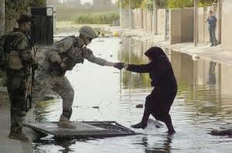
Altruism – The Empathy Motive
Empathy is an emotional response to the perceived plight of another person
  Feel what the other person is feeling
  May entail a sense of tenderheartedness
Positive Psychology: The Scientific and Practical Explorations of Human Strengths © 2014 SAGE

Slide 11
Altruism – The Empathy Motive
C. Daniel Batson, U. of Kansas
- Altruism aimed at promoting another person’s well-being
- Egotistical motives cannot account for helping in certain circumstances
(e.g., my friend who saved a man from drowning)
- Empathy-altruism hypothesis
Having empathy for another = greater likelihood of helping
Positive Psychology: The Scientific and Practical Explorations of Human Strengths © 2014 SAGE

Slide 12
Altruism – The Empathy Motive
Research $5 - $20
  Spend $5 - $20 on self (or another) by end of day
  Higher well-being at the end of the day for those who spent the money on others
Research $5 - $20
  Asked participants to predict if they’d be happier spending $5 or $20 on either themselves or another
  Participants assumed they’d be happier spending the higher amount on themselves
  Reality: those who spent $5 on someone else had the highest well-being at the end of the day
Positive Psychology: The Scientific and Practical Explorations of Human Strengths © 2014 SAGE

Slide 13
Gender, Culture and Altruism
Altruism more often found in female participants, even across age groups
“Dictator Game”
  Distribute fixed number of tokens between self and fictional other person
  Women give more altruistically during this game
Positive Psychology: The Scientific and Practical Explorations of Human Strengths © 2014 SAGE

Slide 14
Gender, Culture and Altruism
Cultural context of social gender norms
  Women who were asked to think intuitively or spend time thinking about how behave with regard to helping someone else
    Women more often behaved altruistically when acting intuitively, especially when identified strongly with traditional female attributes
    Women who were encouraged to deliberate more about their behavior and identified more strongly with traditionally valued male qualities, they exhibited less altruism
Positive Psychology: The Scientific and Practical Explorations of Human Strengths © 2014 SAGE

Slide 15
Gender, Culture and Altruism
Both genders value altruism in long-term relationships
Collectivist cultures have reciprocal relationship between prosocial behavior and social support
Positive Psychology: The Scientific and Practical Explorations of Human Strengths © 2014 SAGE

Slide 16
Religion and Altruism
Relationship between religion, spirituality, and altruism is complex
Religious prosocial reality linked to “in group favoritism” and motive to appear socially desirable
Positive Psychology: The Scientific and Practical Explorations of Human Strengths © 2014 SAGE

Slide 17
Cultivating Altruism
Realize that helping another and feeling good about self are compatible
Legitimate to feel good about helping
How: Volunteer
Positive Psychology: The Scientific and Practical Explorations of Human Strengths © 2014 SAGE

Slide 18
Cultivating Altruism
Increase empathy for others
Frequent interactions with those who need help
Point out similarities
Childhood volunteering predicted later generosity
Positive Psychology: The Scientific and Practical Explorations of Human Strengths © 2014 SAGE

Slide 19
Cultivating Altruism
Personal values
  Studied those that protested Nazi ideology and those who engaged in Civil Rights movement…may incorporate helping into personal identity
Reciprocal effect of role and personality “in the line of duty” jobs
Positive Psychology: The Scientific and Practical Explorations of Human Strengths © 2014 SAGE

Slide 20
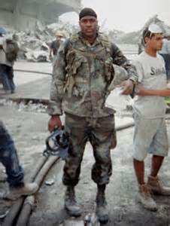
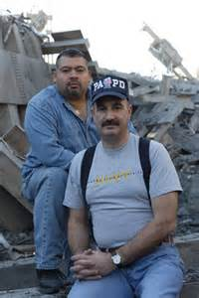
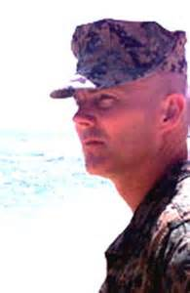
Altruism
Jason Thomas
  Was in Long Island
  Had been out of Marines
  Put on fatigues and drove to NYC
Dave Karnes
  Accountant; was in Wilton CT; left work
  23yr Marine veteran
  Drove to church and asked them to pray that God would lead him to survivors
  Reinlisted
Will Jimeno and John Mcloughlin
A Tribute to Heroes

Slide 21
Measuring Altruism
Self-Report Altruism Scale
Prosocial Behavior Questionnaire
Helping Attitude Scale
Decision – making games
Positive Psychology: The Scientific and Practical Explorations of Human Strengths © 2014 SAGE

Slide 22
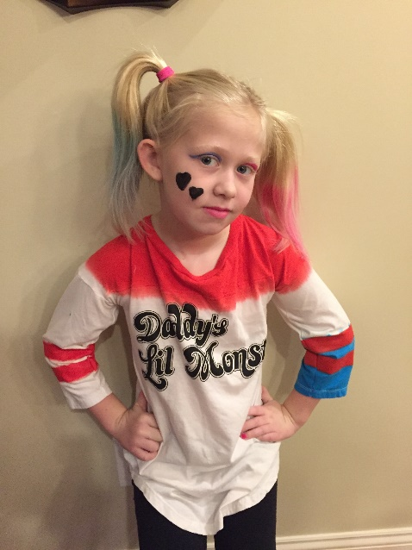
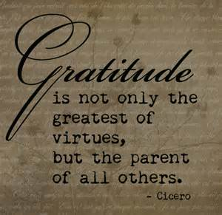
Gratitude
What are you most thankful for in your life?
How often do you feel grateful, and how easy is it for you to express gratitude?
Positive Psychology: The Scientific and Practical Explorations of Human Strengths © 2014 SAGE

Slide 23
Gratitude
Related to a more positive and appreciative outlook toward life, a more positive life orientation (Wood, Maltby, Steward, & Joseph, 2008)
Associated with making positive attributions, which may protect against stress and depression (Lin, 2015)
Positive Psychology: The Scientific and Practical Explorations of Human Strengths © 2014 SAGE

Slide 24
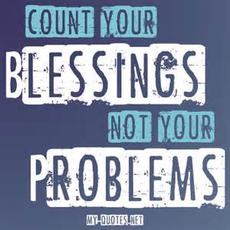
Gratitude: Maslow
Studied self-actualizing people
Found that the abilities to experience
and express gratitude are two key
signs of emotional health
Viewed ancient adage “count your blessings” as relevant today
Suggested ways to nurture gratitude
  Recall the joys of one’s life
  Imagine that one has only a short time left to live
Compton & Hoffman, 2013

Slide 25
Gratitude
Robert Emmons, U. of California – Davis
  Gratitude emerges upon recognizing that one has obtained a positive outcome from another individual who behaved in a way that was:
1. costly to him or her
2. valuable to the recipient
3. intentionally rendered
Positive Psychology: The Scientific and Practical Explorations of Human Strengths © 2014 SAGE

Slide 26
Gratitude
Emmons (2005) described gratitude as “an emotional response to a gift. It is the appreciation felt after one has been the beneficiary of an altruistic act” (p.238)
Research: grateful people tend to be happy people
Positive Psychology: The Scientific and Practical Explorations of Human Strengths © 2014 SAGE

Slide 27
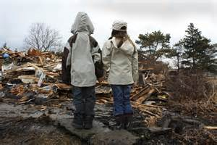
Gratitude
Gratitude can also come
from non-human actions or events
  e.g., surviving a natural disaster
Positive Psychology: The Scientific and Practical Explorations of Human Strengths © 2014 SAGE

Slide 28
Gratitude: Benefit-Finding
A positive cognitive interpretation of setbacks that then place troublesome event in different light
Finding positive outcomes in trauma or loss
  Davis etal (1998): 73% of bereaved people reported positive outcomes
  Similar results for those dealing with seriously ill infant, property damage by tornado, serious medical emergency
  3 categories of benefits:
    Perceptions of self as stronger
    Closer relationships
    Greater clarity concerning what is truly important in life

Slide 29
Gratitude: Benefit-Finding
Results make sense if we consider that up until the crisis, our resilience and strength may not have been tested
  The importance of our relationships may have been taken for granted
  What is most important in life may have been overlooked in the busyness of everyday life

Slide 30
Cultural Variations in Altruism
Westerners tend to prefer the words “ thank you”…produce more positive reactions in US
Easterners preferred use of phrases to help “save face”
Religiousness positively correlated with general gratitude and gratitude towards God
Positive Psychology: The Scientific and Practical Explorations of Human Strengths © 2014 SAGE

Slide 31
Cultivating Gratitude
Keeping weekly gratitude journal related to:
- Increased exercise
- Optimism
- Feeling better about life
- Enthusiasm
Positive Psychology: The Scientific and Practical Explorations of Human Strengths © 2014 SAGE

Slide 32
Benefits of Gratitude
Gratitude related to:
- alertness
- determination
- goal progress
- helping behavior
Positive Psychology: The Scientific and Practical Explorations of Human Strengths © 2014 SAGE

Slide 33
Benefits of Gratitude
Gratitude related to:
- life satisfaction
- less negative affect
- positive feelings about school
- emotional closure to bad events
Positive Psychology: The Scientific and Practical Explorations of Human Strengths © 2014 SAGE

Slide 34
Cultivating Gratitude
Gratitude journaling
Counting your blessings
Recall joys in life
Imagine short time to live
Gratitude visit
Letter writing of thanks
Positive Psychology: The Scientific and Practical Explorations of Human Strengths © 2014 SAGE

Slide 35
Cultivating Gratitude
Naikan
- Japanese form of meditation
- meditate daily on 3 questions:
1. What did I receive?
2. What did I give?
3. What troubles and difficulties did I cause to others?
Positive Psychology: The Scientific and Practical Explorations of Human Strengths © 2014 SAGE

Slide 36
Measuring Gratitude
Gratitude listing
Code gratefulness stories
Behavioral measures
Thanksgiving subscale of the Multidimensional Prayer Inventory
Positive Psychology: The Scientific and Practical Explorations of Human Strengths © 2014 SAGE

Slide 37
Measuring Gratitude
2 trait-like gratitude measures:
- Gratitude, Resentment, & Appreciation Test (GRAT)
- Gratitude Questionnaire (GQ-6)
(p. 297)
Positive Psychology: The Scientific and Practical Explorations of Human Strengths © 2014 SAGE

Slide 38
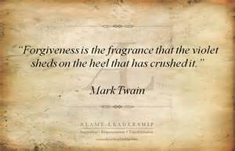
Forgiveness
Variety of definitions
Most see forgiveness in terms of its potential ability to offset the debilitating effects of the anger and hostility associated with a desire to avenge the hurtful act of another (in Baumgartner and Crothers, 2009)
Consensus = forgiveness is beneficial
Positive Psychology: The Scientific and Practical Explorations of Human Strengths © 2014 SAGE

Slide 39
Forgiveness
Thompson and Colleagues
- A freeing from a negative attachment to the source that has transgressed against a person
- Target of forgiveness: self, another, or a situation
Positive Psychology: The Scientific and Practical Explorations of Human Strengths © 2014 SAGE

Slide 40
Forgiveness
McCullough and Colleagues
- Increases prosocial motivation toward another resulting in:
1. Less desire to avoid transgressor or to seek revenge
2. Increased desire to act positively toward transgressor
Positive Psychology: The Scientific and Practical Explorations of Human Strengths © 2014 SAGE

Slide 41
Forgiveness
Enright and Colleagues
- “A willingness to abandon one’s right to resentment, negative judgment, and indifferent behavior toward one who unjustly hurt us, while fostering the undeserved qualities of compassion, generosity, and even love toward him or her”
Crucial that forgiving person develop a benevolent stance toward the transgressing person
Positive Psychology: The Scientific and Practical Explorations of Human Strengths © 2014 SAGE

Slide 42
Forgiveness
Tangney and Colleagues
- Cognitive-affective transformation
- Freely choosing to “cancel the debt” & give up the need for revenge
- Giving up negative emotions is key
- Removing self from the victim role
Positive Psychology: The Scientific and Practical Explorations of Human Strengths © 2014 SAGE

Slide 43
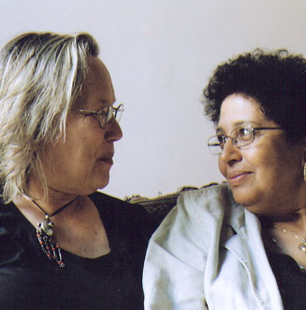
Forgiveness
9-11 Mothers and Forgiveness
Positive Psychology: The Scientific and Practical Explorations of Human Strengths © 2014 SAGE

Slide 44
Culture and Forgiveness
Forgiveness as:
- interpersonal process
- intrapersonal process
More common in Eastern cultures due to value of social harmony
Situational factors and cultural norms
Positive Psychology: The Scientific and Practical Explorations of Human Strengths © 2014 SAGE

Slide 45
Culture and Forgiveness
Studies are mixed on whether men or women have stronger responses to forgiveness prompts
African-Americans show link between forgiveness and health
Personal identity of religiosity may affect tendency to forgive
Religion emphasizes forgiveness and reconciliation; psychology does not always include reconciliation.
Positive Psychology: The Scientific and Practical Explorations of Human Strengths © 2014 SAGE

Slide 46
Increasing Forgiveness
Forgiveness more likely when
Transgressor accepts responsibility
Transgressor apologizes
Transgressor attempts to “ make things right”
Older people more willing to forgive
Positive Psychology: The Scientific and Practical Explorations of Human Strengths © 2014 SAGE

Slide 47
Cultivating Forgiveness
Interpersonal Forgiveness - Gordon, Baucom, & Snyder
Three Steps:
    Non– distorted relationship appraisal
    Release from rumination/negative affect
    Lessen desire to punish transgressor
Three Stages
    Initial impact stage
    Search for meaning
    Recovery stage

Slide 48
Cultivating Forgiveness
REACH Model by Everett Worthington
Recall the hurt
Empathize
Altruistically give the gift of forgiveness
Commit verbally to forgive
Hold onto the forgiveness
Positive Psychology: The Scientific and Practical Explorations of Human Strengths © 2014 SAGE

Slide 49
Cultivating Forgiveness
Self-forgiveness:
- shame
- guilt
“I did a bad thing.”
Involves taking responsibility for bad act or actions, then let go and move forward
Positive Psychology: The Scientific and Practical Explorations of Human Strengths © 2014 SAGE

Slide 50
Measuring Forgiveness
Heartland Forgiveness Scale
Transgression-Related Motivations Inventory (TRIM)
Enright Forgiveness Inventory
Positive Psychology: The Scientific and Practical Explorations of Human Strengths © 2014 SAGE

Slide 51
Measuring Forgiveness
Willingness to Forgive Scale
Multidimensional Forgiveness Inventory
Positive Psychology: The Scientific and Practical Explorations of Human Strengths © 2014 SAGE

Slide 52
Personal Benefits of Altruism, Gratitude, and Forgiveness
Altruism – reciprocal relationship between mood and tendency to help; associated with agreeableness, openness to experience, honesty, and humility
Gratitude –correlated with positive emotions, vitality, optimism, hope, and satisfaction with life. Less concern with material goods and greater concern with spiritual matters
Positive Psychology: The Scientific and Practical Explorations of Human Strengths © 2014 SAGE

Slide 53
Personal Benefits of Altruism, Gratitude, and Forgiveness
Forgiveness
Correlated with physical and mental health/well-being
Less ruminative, less depressed
Longevity associated with practicing forgiveness
Satisfaction with relationships associated with practicing forgiveness
Positive Psychology: The Scientific and Practical Explorations of Human Strengths © 2014 SAGE

Slide 54
Societal Implications
Empathy & Altruism:
  We tend to mute our sense of empathy
  http://www.littlethings.com/homeless-man-mcdonalds/
  Innocent bystander effect
  https://video.search.yahoo.com/video/play;_ylt=A0LEV7mQehVVsU4AzjQnnIlQ;_ylu=X3oDMTB0b2ZrZmU3BHNlYwNzYwRjb2xvA2JmMQR2dGlkA1lIUzAwMl8x?p=bystander+effect&tnr=21&vid=3E1EBA9A4427BC0AB5A93E1EBA9A4427BC0AB5A9&l=118&turl=http%3A%2F%2Fts3.mm.bing.net%2Fth%3Fid%3DUN.608019618452014930%26pid%3D15.1&sigi=11r7r7njc&rurl=https%3A%2F%2Fwww.youtube.com%2Fwatch%3Fv%3DJcowGVd6GqY&sigr=11bvn3g2s&tt=b&tit=The+Bystander+Effect+-+experiment&sigt=111lhnc4m&back=https%3A%2F%2Fsearch.yahoo.com%2Fyhs%2Fsearch%3Fp%3Dbystander%2Beffect%26ei%3DUTF-8%26hsimp%3Dyhs-001%26hspart%3Dmozilla&sigb=12smj1o6v&hspart=mozilla&hsimp=yhs-001
  https://video.search.yahoo.com/video/play;_ylt=A0LEV7mQehVVsU4AzjQnnIlQ;_ylu=X3oDMTB0b2ZrZmU3BHNlYwNzYwRjb2xvA2JmMQR2dGlkA1lIUzAwMl8x?p=bystander+effect&tnr=21&vid=3E1EBA9A4427BC0AB5A93E1EBA9A4427BC0AB5A9&l=118&turl=http%3A%2F%2Fts3.mm.bing.net%2Fth%3Fid%3DUN.608019618452014930%26pid%3D15.1&sigi=11r7r7njc&rurl=https%3A%2F%2Fwww.youtube.com%2Fwatch%3Fv%3DJcowGVd6GqY&sigr=11bvn3g2s&tt=b&tit=The+Bystander+Effect+-+experiment&sigt=111lhnc4m&back=https%3A%2F%2Fsearch.yahoo.com%2Fyhs%2Fsearch%3Fp%3Dbystander%2Beffect%26ei%3DUTF-8%26hsimp%3Dyhs-001%26hspart%3Dmozilla&sigb=12smj1o6v&hspart=mozilla&hsimp=yhs-001
  https://video.search.yahoo.com/video/play;_ylt=A0LEV7mQehVVsU4AzTQnnIlQ;_ylu=X3oDMTB0b2ZrZmU3BHNlYwNzYwRjb2xvA2JmMQR2dGlkA1lIUzAwMl8x?p=bystander+effect&tnr=21&vid=48ACFDC1457D3C1DC75448ACFDC1457D3C1DC754&l=388&turl=http%3A%2F%2Fts1.mm.bing.net%2Fth%3Fid%3DUN.608037060316171280%26pid%3D15.1&sigi=11rg60351&rurl=https%3A%2F%2Fwww.youtube.com%2Fwatch%3Fv%3DKIvGIwLcIuw&sigr=11bfd5q1n&tt=b&tit=Bystander+Effect+-+people+watch+girl+being+abducted&sigt=11jhoufce&back=https%3A%2F%2Fsearch.yahoo.com%2Fyhs%2Fsearch%3Fp%3Dbystander%2Beffect%26ei%3DUTF-8%26hsimp%3Dyhs-001%26hspart%3Dmozilla&sigb=12smj1o6v&hspart=mozilla&hsimp=yhs-001
Need to find ways to enhance empathy and to help people remain empathic
  e.g, police officers, psychologists, helping professions who experience job burnout
Positive Psychology: The Scientific and Practical Explorations of Human Strengths © 2014 SAGE

Slide 55
Societal Implications
Egotism & Altruism:
Empathy is a precursor to forgiving
Teach others that helping and feeling good is good!
Legitimize helping to feel good in society at large
Gratitude as moral imperative
Positive Psychology: The Scientific and Practical Explorations of Human Strengths © 2014 SAGE

